Slide 1
Capstone Project
Airbnb Booking Analysis
By Rupali Sawant

Slide 2
CONTENT
Introduction
Problem statement
Key objective
Data wrangling
Data description
Tools
Key findings
Challenges faced
Conclusion

Slide 3

INTRODUCTION
Airbnb is an American company that operates an online marketing place for lodging, homestays for vacation and the tourism activities.
The platform accessible via website and mobile app. Airbnb does not own any of the listed properties.
During the last few years, the popularity of Airbnb rose to much so that is considered as rival for all the hotels industries.

Slide 4
PROBLEM STATEMENT
Given is a rich dataset of New York 2019 Airbnb Analysis which includes important details such as area , price , host name etc.
Explore and analyze the data to have an understanding of how the Airbnb is being operated in NYC and the various factors responsible for the ups and downs the business.
This dataset has around 49,000 observations in it with 16 columns and it is a mix between categorical and numeric values.

Slide 5
KEY OBJECTIVES
What can we learn about different hosts and areas ?
What can we learn from predictions ?(ex:location,prices,reviews,etc)
Which hosts are the busiest and why ?
Is there any noticeable difference of traffic among different areas and what could be the reason for it ?

Slide 6
DATA WRANGLING
Dropping unnecessary data :
‘last_review’ and ‘reviews_per_month’ have more than 10,000 null values and its affects the outcomes of Data Analysis. So we removing these columns and we are not doing any analysis on longitude and latitude.
Verifying data quality :
We gone through the whole data and checked null values and reviews any missing data or wrong data.

Slide 7
DATA DISCRIPTION
df has 48895 rows and 16 columns.
Column Name | Description
id | Unique id for each listing
name | Name of the place of stay
host_id | Unique id for each host
host_name | Host name
Neighbourhood_group | Represent 5 main boroughts of New York. They are Manhattan , Brooklyn, Queen, Staten Island and Bronx.
neighbourhood | Location of these listing , there in 221 unique neighbourhoods.
latitude | Latitude coordinates.

Slide 8
DATA DISCRIPTION Cont…
Column Name | Discription
longitude | Longitude coordinates
room_type | There are 3 types of room :Shared room,Private room and Entire Apartment
price | Price of each listing
minimum_nights | Minimum number of nights for which booking is possible
number_of_reviews | Total number of reviews
last_reviews | Latest review
reviews_per_month | Number of reviews per month on an average
calculate_host_listings_count | Number of listings per host
availability_365 | Number of days for which the listing available for booking

Slide 9

TOOLS
Tools used for EDA :
Programming language : Python
Libraries : Pandas, Matplotlib , seaborn
Microsoft Excel

Slide 10
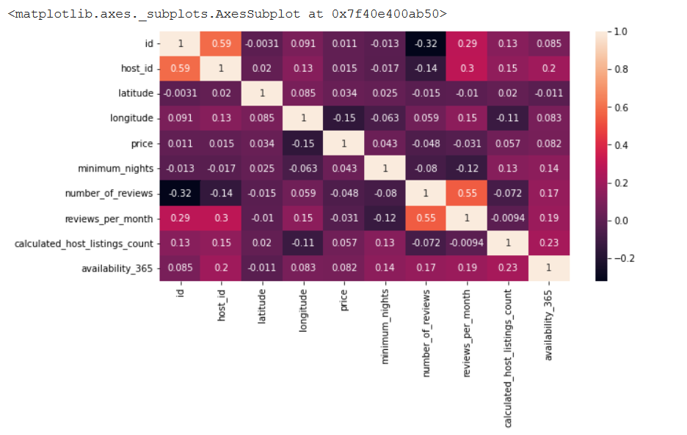
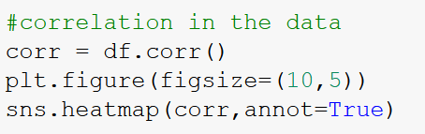
CORRELATION HEATMAP
Drawn a correlation between all the numerical variables in the dataset by the plotting heatmap using a seaborn.

Slide 11
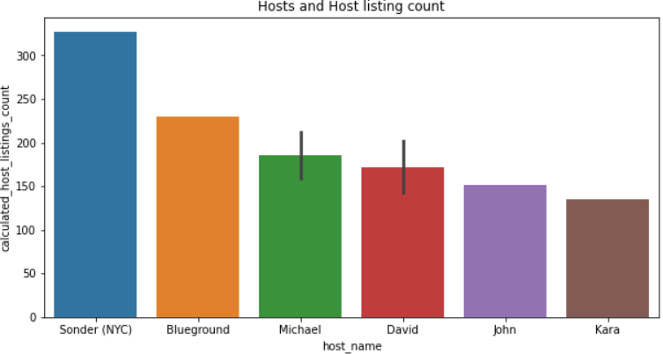
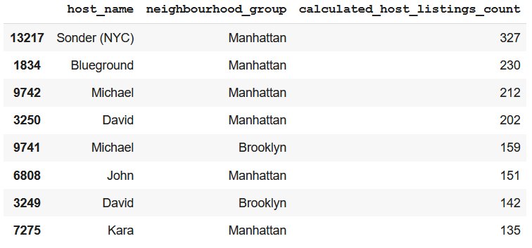
1) Top hosts and their listings count :
For analysing this we used group by function and took ‘host_name’ , ‘neighbourhood_group’ and the ‘calculated_host_listings_count’

Slide 12
Key finding :
In their 6 out of top 8 hosts are from the ‘Manhattan’ neighbourhood group.
2 out of top 8 hosts are from the ‘Brooklyn’ neighbourhood group.
[ Sonder(NYC), Blue ground, Michael, David, John, Kara] are the top hosts in Manhattan neighbourhood group.
[Michael,David] are the top hosts in Brooklyn neighbourhood group.
Manhattan neighbourhood group hosts are out-performing in listings.

Slide 13
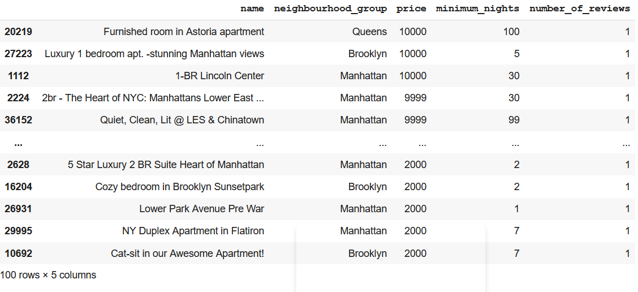
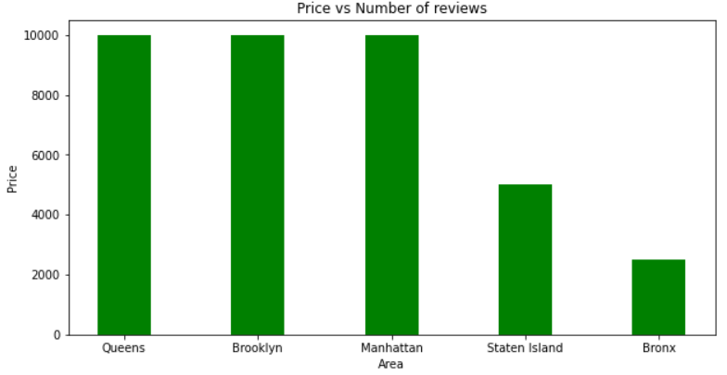
2) Max prices and reviews :
In this question, we approaches with the ‘name’ , ‘neighbourhood_group’ , ‘neighbourhood’ , ‘price’ , ‘minimum_nights’ , ‘number_of_reviews’

Slide 14
Key findings :
The highest price is 10,000 $.
Most minimum nights spend in top 20 price list are,
- Luxury TriBeCa Apartment at an amazing price -180 nights
-Furnished room in Astoria apartment-100 nights
-Quiet, Clean , Lit@ LES & Chinatown – 99 nights
Highest prices rooms (i.e. 10,000$) are all present in Manhattan,Brooklyn and Queens neighbourhood group.

Slide 15
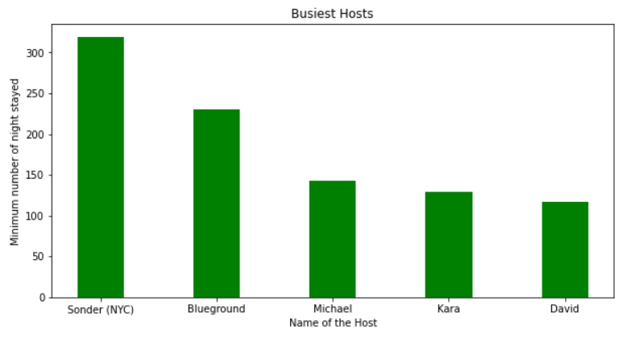
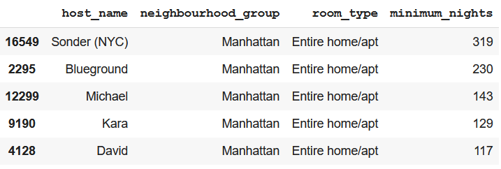
4)Finding Busiest Host
Finding the busiest hosts by considering ‘minimum_nights’ bookings their hotels. We took the ‘host_name’ , ‘neighbourhood_group’ , ‘room_type’ , ‘minimum_nights’.

Slide 16
Key findings :
5 out of top 5 all are from ‘Manhattan’ neighbourhood’ group.
The top 5 most busiest hosts are , Sonder (NYC), Blue ground, Michael, Kara, David .

Slide 17
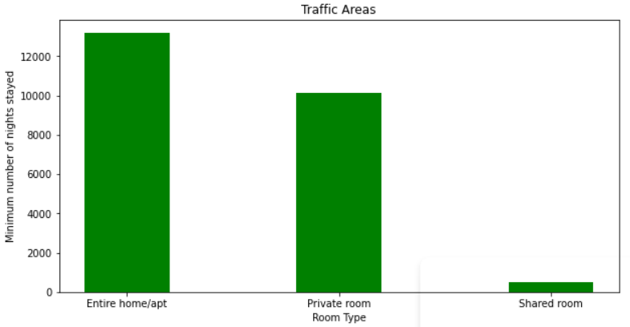
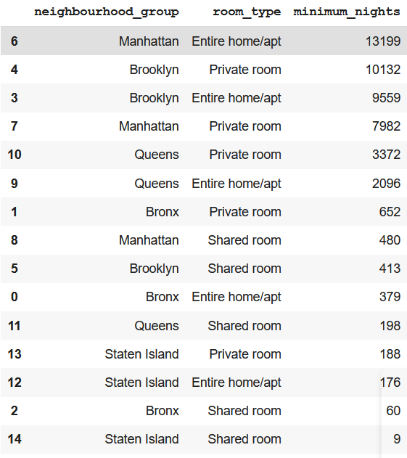
3)Traffic among different room types and different neighborhood
In this step was the find traffic among different types of rooms at different neighbourhood groups.
For this we took, ‘ neighbourhood_group’, ‘room_type’ and ‘minimum_nights’ for analyzing.

Slide 18
Key findings :
In Manhattan, people are preferring ‘Entire Home/Apt’
But Brooklyn, Queens and Bronx people are preferring private rooms.
In Staten Island, people are having equal preference over all three types of rooms.

Slide 19
CHALLENGES FACED
Verifying the quality of such huge data and looking for error values.
Dropping down irrelevant data and making the whole data getting ready for the data analysis.
Understanding and visualizing complex numerical data.
Analyzing and solving various queries and presenting the outputs.

Slide 20
CONCLUSION
Airbnb dataset-2019 appeared to be a very rich dataset with the variety of columns the allowed us to do deep data exploration on each significant column presented.
First, we have found the hosts that takes good advantage of the Airbnb platform and the providing listings; we found that our top host has 327 listings. After that, we proceed with analysing boroughts and neighbourhood listing densities and what areas were more popular than another.
From the entire analysis on Airbnb booking analysis, our assumptions before analysis went totally different after getting result from the analysis. The whole EDA process gave a very fascinating result and insight that will be helpful for business development and the expansion, budget allocations and focusing on things people prefer.

Slide 21
Thank You

